Slide 1



ISFMG 2026
at Indian Institute of Technology Indore
06-10 Aug 2026

Slide 2
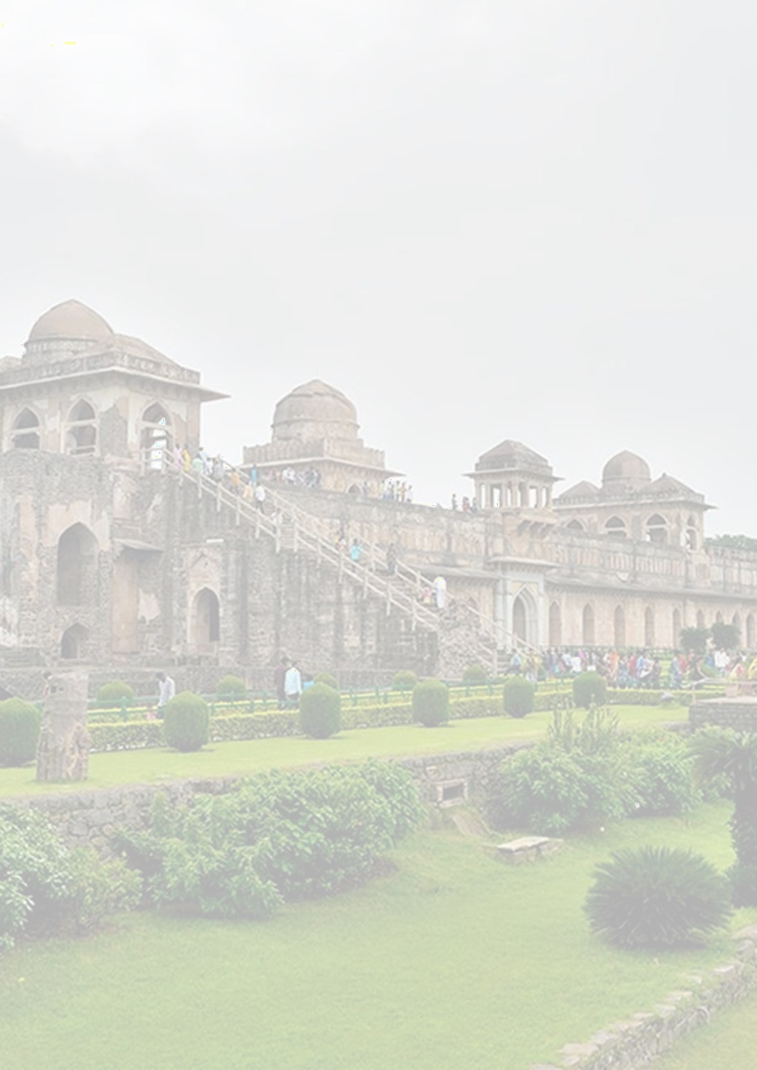

THEMES OF SYMPOSIUM
Tunnels and Underground Spaces
Tunnels and Underground Spaces" as a symposium theme explores the intricate world beneath the surface, unveiling the engineering marvels, scientific advancements, and multifaceted aspects of subterranean environments.
Bridges and Transport Infrastructure
Participants will engage in discussions surrounding sustainable and resilient infrastructure development, smart transportation systems, and the integration of emerging technologies such as artificial intelligence and renewable energy.
Dams and Embankments
This theme invites exploration into the critical role of hydraulic engineering in water resource management and infrastructure development.
Slopes and Earthworks
Under this theme the design, analysis, and management of slopes, embankments, and earthworks, addressing challenges related to erosion control, landslide prevention, and infrastructure resilience.
Buildings and Foundations
Buildings and Foundations" as a symposium theme explores the fundamental aspects of structural engineering, construction, and foundation design that underpin the built environment.
Mining and Landfill
Mining and Landfill" as a theme delves into the dynamic realms of resource extraction and waste
management.
Environmental Monitoring
This theme explores the latest advancements in monitoring technologies, data analytics, and methodologies for tracking changes in air quality, water resources, biodiversity, climate patterns, and more.
The Observational Method
The Observational Method involves systematically and passively observing natural behaviors or phenomena, providing real-time insights without direct intervention.
Specifications and Standards
This theme covers the pivotal role of meticulously defined requirements and universally accepted benchmarks across diverse industries.
Excavation and Retaining Structure
This symposium explores the latest advancements in excavation techniques, soil stabilization, and the design and construction of retaining structures.
Inverse Modelling
This symposium delves into the applications of inverse modeling across various disciplines, such as environmental science, geophysics, and engineering.
Advanced Design Technology
This symposium delves into innovations such as computational design, artificial intelligence, generative design, and virtual prototyping.
OFFICIAL LANGUAGE: The official language of the Symposium is English. Papers shall be written and presented in English.
VENUE: INDIAN INSTITUTE OF TECHNOLOGY INDORE, INDIA
Indian Institute of Technology Indore, located in Madhya Pradesh, known as IIT Indore or IITI, is an institute of national importance established by the Government of India in 2009. IIT Indore is officially recognized as an Institute of National Importance by the Government of India. The institute has been ranked 14 as Engineering Institute in India National Institutional Ranking Framework (NIRF) 2023.
The Institute is well connected with the city through Khandwa Road. The Devi Ahilyabai Holkar International airport is approximately 32 km from IIT Indore campus. Indore Railway Station is approximately 24 km from IIT Indore campus.

Slide 3

12th ISFMG 2026
The International Symposium on Field Monitoring in Geomechanics (ISFMG) 2026 is a highly anticipated event that brings together experts in the field of geomechanics from all over the world. The Symposium is organized under TC 220 of the International Society of Soil Mechanics and Geotechnical Engineering, which deals with Field Monitoring in Geomechanics. This symposium aims to provide a platform for the exchange of knowledge and ideas related to geomechanics field monitoring. The symposium will consist of keynote lectures, technical sessions, and poster presentations, allowing participants to learn from and engage with leading researchers and practitioners in the field. The technical sessions will cover a wide range of topics, including field instrumentation and monitoring techniques, geomechanics modeling, and case studies in geotechnical and geo-environmental engineering. ISFMG 2026 is an excellent opportunity for researchers, academics, and practitioners to network, exchange knowledge, and showcase their research findings. Participants will gain insight into the latest advancements in the field of geomechanics and have the opportunity to present their own work to an international audience
INDIAN GEOTECHNICAL SOCIETY (IGS)
The Indian Geotechnical Society (IGS) is a professional organization of geotechnical engineers, geologists, and other related professionals in India. It was founded in 1948 and is the premier professional organization in India for those interested in geotechnical engineering, engineering geology, and related fields. The Indian Geotechnical Society is celebrating its 75th anniversary in the year 2023.
Society aims to promote the advancement and dissemination of knowledge and information related to geotechnical engineering, engineering geology, and allied disciplines. It provides a platform for its members to exchange ideas, share knowledge, and collaborate on research and practice. IGS is an Affiliated Member of The International Society for Soil Mechanics and Geotechnical Engineering (ISSMGE). It has a total of 91 representatives in 35 Technical Committees of ISSMGE.
Convener: Prof. Neelima Satyam Co-convener: Dr. Anil Joseph Organizing Secretary: Dr. A.P. Singh Prof. S.K. Prasad | Local-Organizing Committee: Prof. A.N. Patel Dr. Baadiga Ramu Mr. Anupam Bidasaria Dr. Abhay Gupta Dr. Amit Sharma Mr. Govind Parchani Mr. Kapil Bhalla Dr. Monika Dagliya Mr. Ravindra Gupta Dr. Raghvendra Singh Prof. Satish Sharma Dr. Sanjay Verma Dr. Vandana Tare Dr. Kunal Gupta

Slide 4
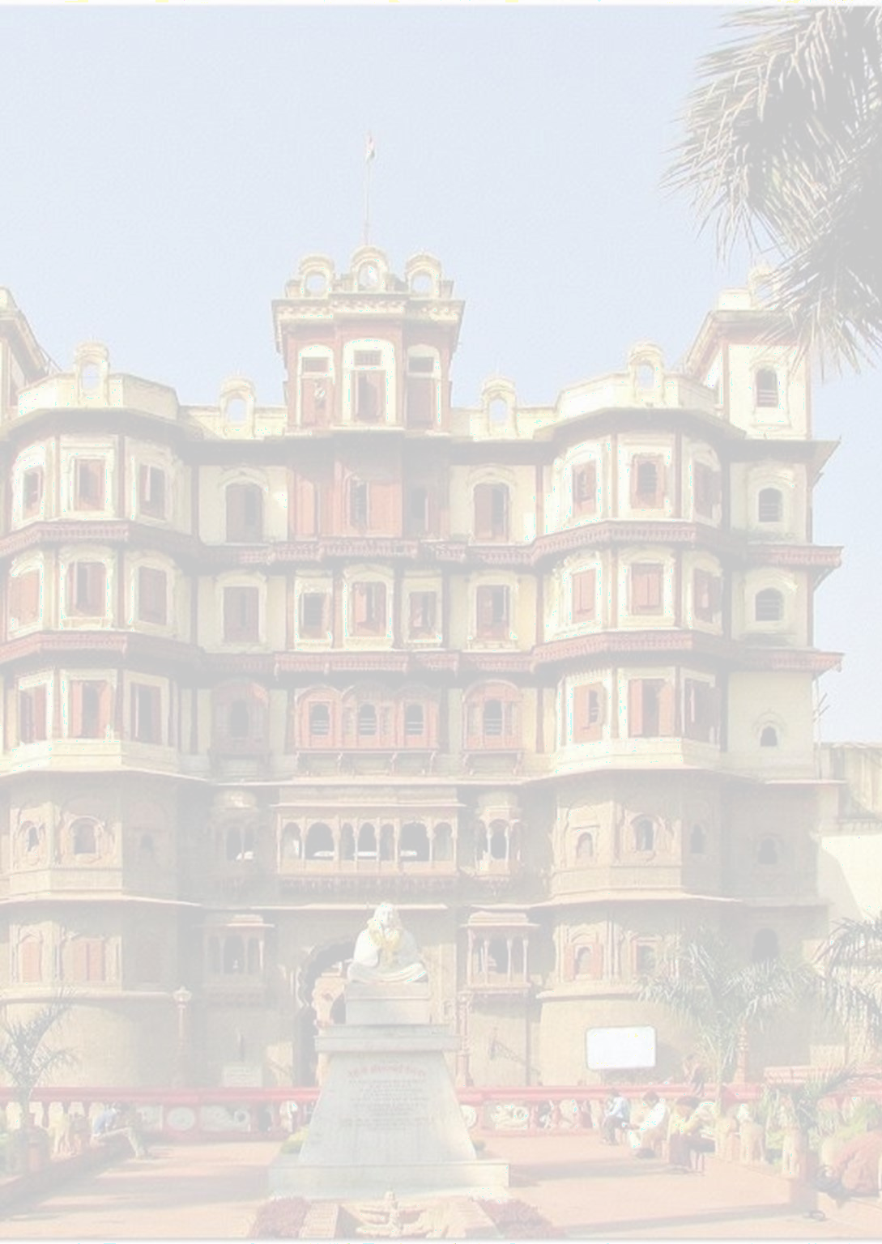
SPONSORSHIP PROSPECTUS
Category | Amount | Entitlements
Platinum Sponsor | $12,000 USD/ 10,00,000 INR | Three passes for the conference. Company logo on the conference website. Exhibition space in a prominent location at the exhibition area Acknowledgement at opening and closing sessions. Logo on all conference promotional material including bag.
Gold Sponsor | $9,600 USD/8,00,00 0 INR | Two passes for the conference. Company logo on the conference website. Acknowledgement at opening and closing sessions. Logo on all conference promotional material including bag.
Silver Sponsor | $6,000 USD/5,00,00 0 INR | One pass for the conference Company logo on the conference website. Acknowledgement at opening and closing sessions. Logo on all conference promotional material including bag.
Bronze Sponsor | $4,800 USD/4,00,00 0 INR | Company logo on the conference website. Acknowledgement at opening and closing sessions. Logo on all conference promotional material including bag.
As part of the exhibitor package, we are pleased to offer the following:
Item | Description
Exhibitor Fee | ₹1,50,000 + GST
Offerings | One booth of 8x8 feet size One pass for the conference
GST @18% is Applicable as per Government Rules
Payment Information for ISFMG 2026
Bank Name: CANARA Bank Account Number: 110161118541 Account Holder: ISFMGE 2026 IFSC code: CNRB0006223 SWIFT code: CNRBINBBBFD

